Slide 1
Graduation project
Embedded systems
LCD PWM drawer
Ali Mohamed Mohamed

Slide 2
Motivation:
Oscilliscope is a device to draw different types of signals including the square signal of the PWM.
Our aim is to draw the same PWM square signal on the LCD instead of the oscilliscope.
The specifications of LCD is much weaker the oscilliscope’s specifications which will give us a little unaccurate visualization for the PWM square signal.
So that the LCD will be representing a general view for the PWM signal.

Slide 3
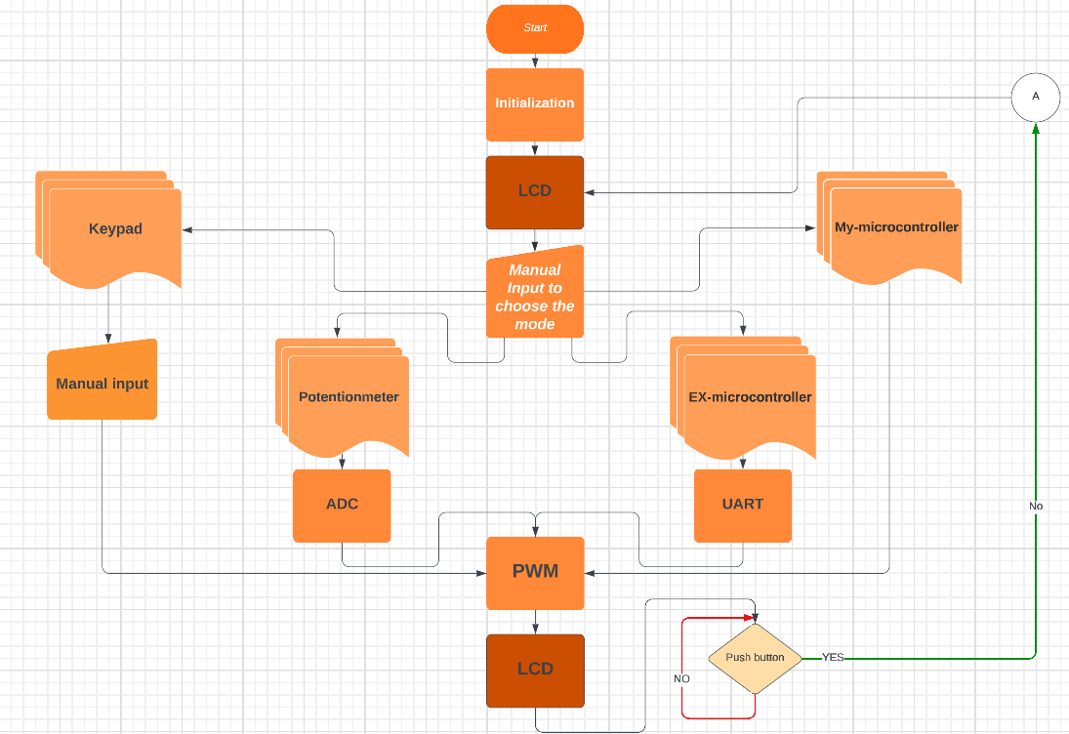
Flow-chart for the whole project:

Slide 4
A-Welcome screen:
In this screen we introduce the “Welcome” word in case the current user is the first one to use the system after openning.
After that we ask the user to choose between the four available modes:
1- My-Microcontroller(My-MC):
The source of the PWM signal is the main microcontroller that operates the system.To modify the form of the shown signal on LCD, you must modify in the code of the main microcontroller’s software.

Slide 5
2-External-Microcontroller(EX-MC):
The source of the PWM signal is an external microcontroller, and it communicates with the main microcontroller using the UART.To modify the shape of the shown PWM signal you must modify the code of the external microcontroller’ software.
3-Potentionmeter(Poten):
This mode uses the ADC(analoge to digital converter) to read the reading on pin PA0 of the main microcontroller which is connected to a potentiometer, the duty cycle of the PWM is calcutated as following :

Slide 6


where: ADC-VALUE-REG : is a register contains the ADC result
` Pin-reading : is the input to the microcontroller’s PA0 pin
AREF-PIN : is the pin on which the reference to which the micro-controller compares the PA0 reading is
connceted.
The duty cycle is calculated by comparing the value which is stored inside the ADC-VALUE-REG with the maximum value that the ADC-VALUE-REG can store which is 1024. 1024 is written as 1024.0 to turn the division into float division instead of interger divison. Finally we get the percentage which represents the duty cycle.

Slide 7
4-Keypad:
This mode asks the user about everything: The number of waves that he wants to show and the duty cycle of the PWM signal. The user enters this information using the keypad through an user-familiar interface.

Slide 8
B-PWM drawer function:
This is the function which is responsible for showing the PWM square signal on the LCD with the required specifications.
The information (parameters) which are necessary to be provided for the function to operates:
1-Needed number of waves.
2-Duty cycle.
Then the function does some calculations to provide the required signal according to LCD specifications.

Slide 9


The function does the following calculations :
where 16 : the available maximum number of characters in single line on the LCD.
High-Period : No. of characters that will represent the logic-1 period.
Low-Period : No. of characters that will represent the logic-0 period.
The function makes sure if the required wave can be drawn with the required specifications on the LCD or not by making sure that neither of the High-Period nor Low-Period calculations give zero. If not, the program warns the user by writing “Invalid required number of waves” on the LCD.

Slide 10
C-Finally:
To stop using one mode and return to the welcome screen,
click the push button connected to PD2 pin of the main microcontroller and that action will be accomplished.

Slide 11
Simulation
Two ATmega32 microcontrollers was used: one as main microcontroller and the other represents the external microcontroller necessary for the external-microcontroller (EX-MC) mode.
LCD 16x2 is used.
4 leds are used to light with distiguish colour when operating on each mode.
1- Yellow My-MC 2-Red EX-MC
3-Green Poten 4-Blue Keypad

Slide 12

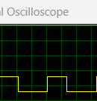
A sample from the shown PWM square signal on LCD on fig.(1)
A sample from the shown PWM square signal on the oscilliscope on fig.(2)
fig.(1)
fig.(2)

Slide 13
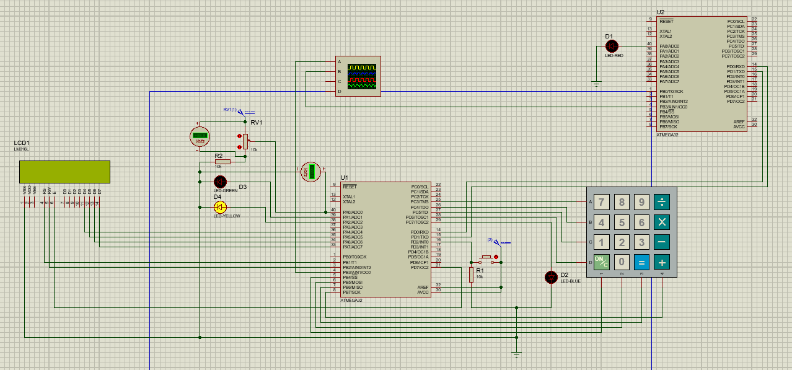
The whole circuit:

